Slide 1
Topic 1

Slide 2
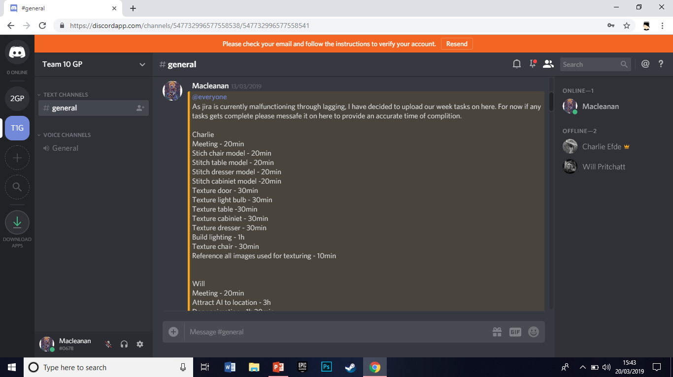
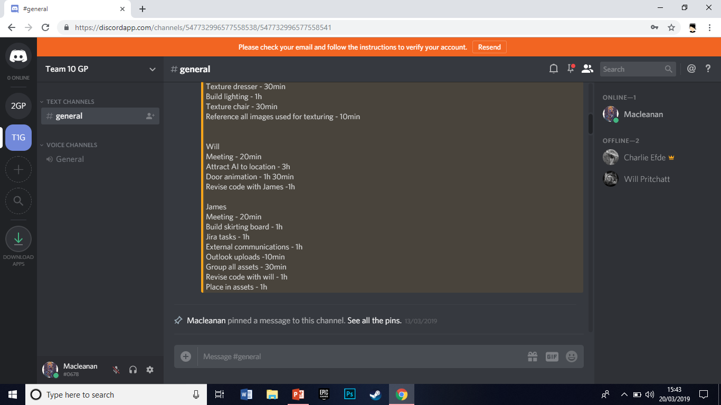

Slide 3
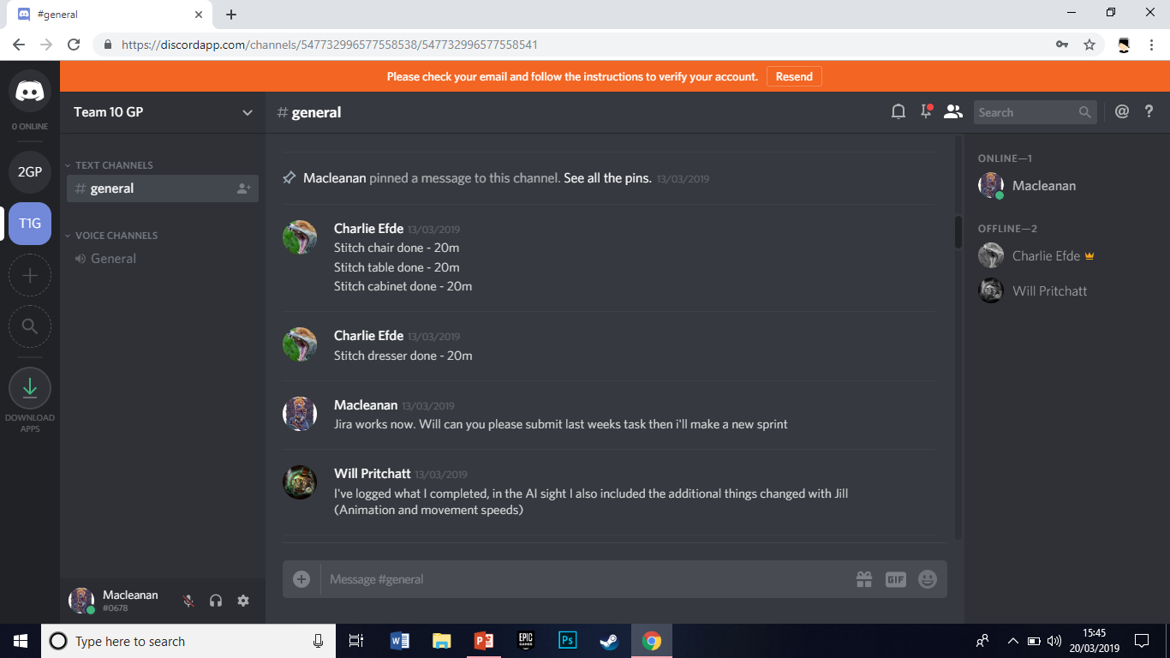

Slide 4
Topic 2

Slide 5
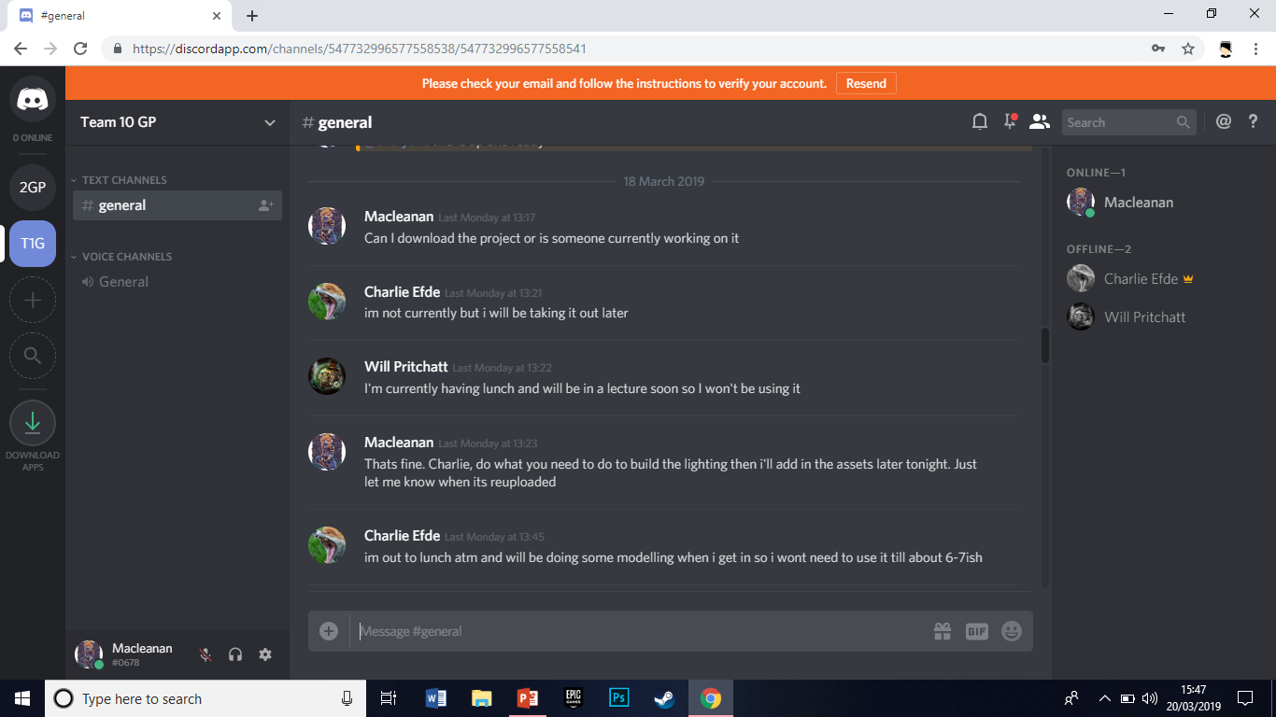

Slide 6
Topic 3

Slide 7

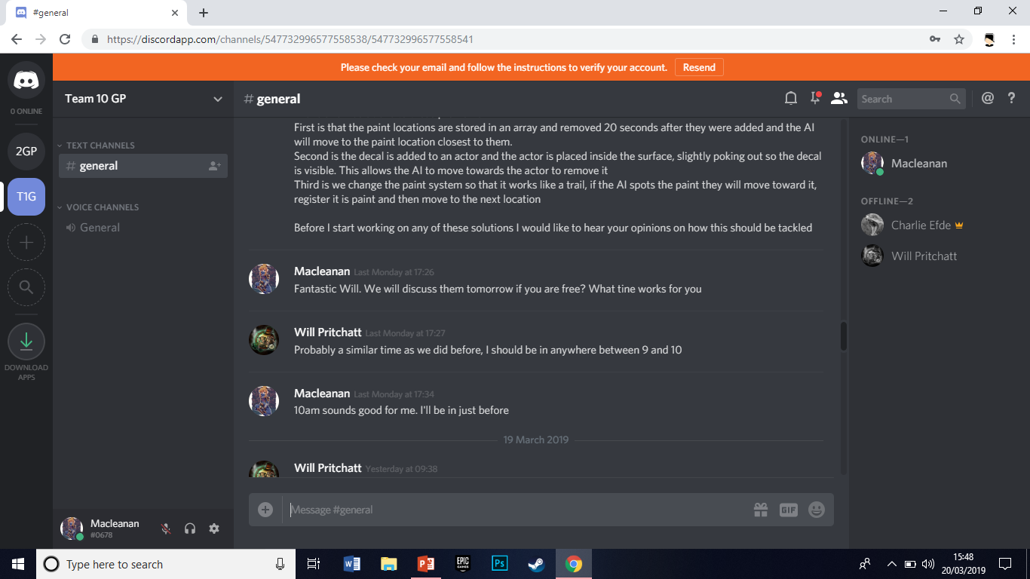

Slide 8
Topic 4

Slide 9

